Slide 1
WFE Fresher Presentation
HOTEL WEB APP
HO LE HOANG SON

Slide 2
Contents
Feature
Sourcetree
Responsive With Bootstrap
SASS
AngularJS
UI-Router
Demo

Slide 3
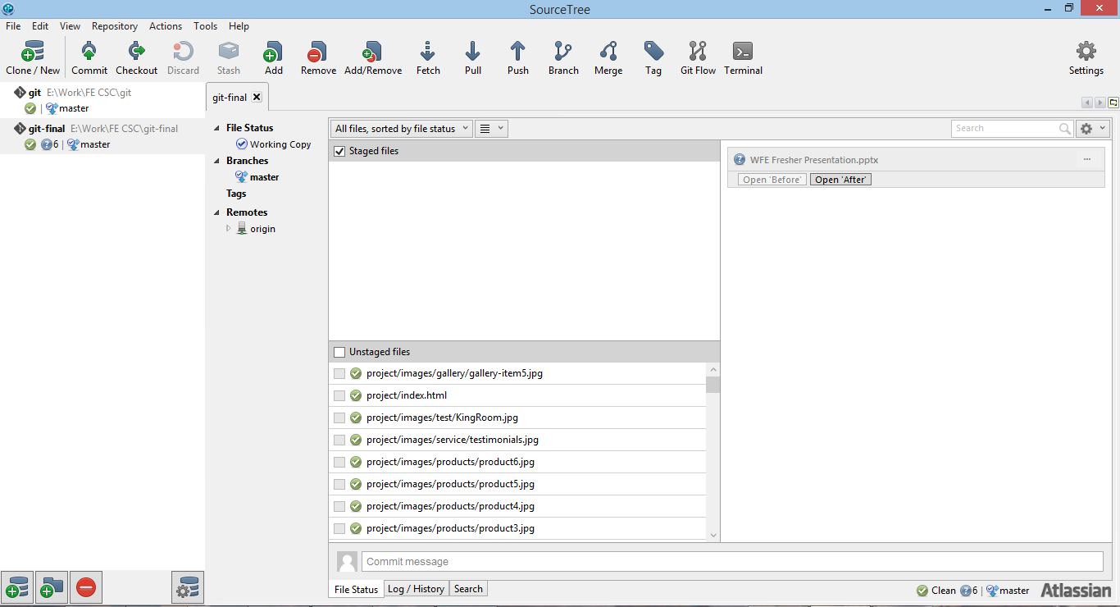

Sourcetree
https://www.sourcetreeapp.com/

Slide 4

Responsive With Bootstrap
http://getbootstrap.com/
bootstrap.min.css

Slide 5
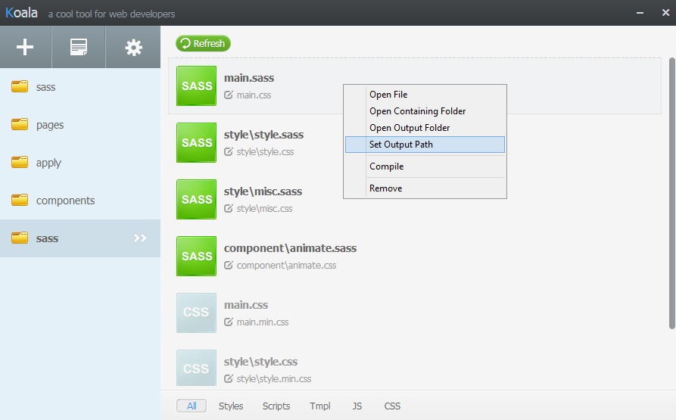
SASS
http://koala-app.com/

Slide 6
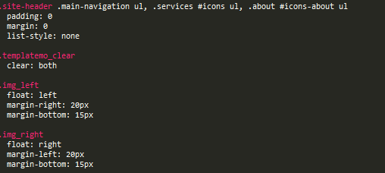
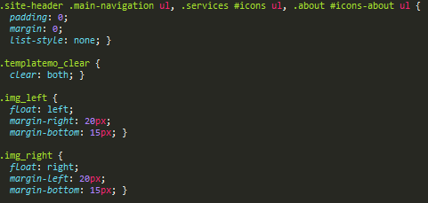
SASS
Convert

Slide 7
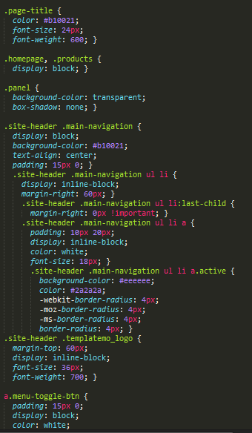

SASS
Import

Slide 8

SASS
Utilities

Slide 9
AngularJS
https://angularjs.org/
angular.min.js

Slide 10
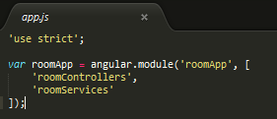
AngularJS
Utilities

Slide 11
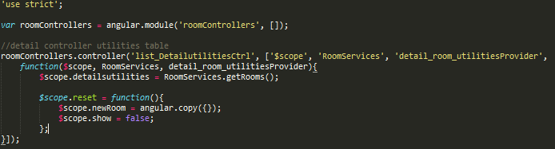
AngularJS
Controllers & Services

Slide 12
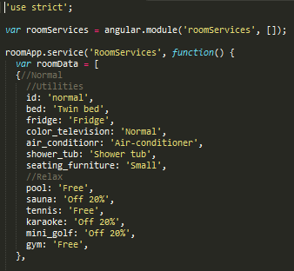
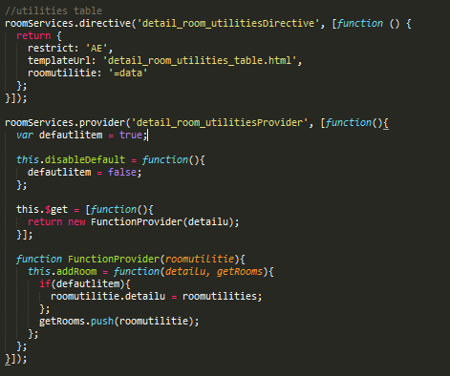
AngularJS
Controllers & Services

Slide 13

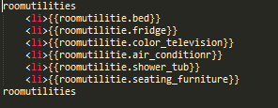
AngularJS
Controllers & Services

Slide 14
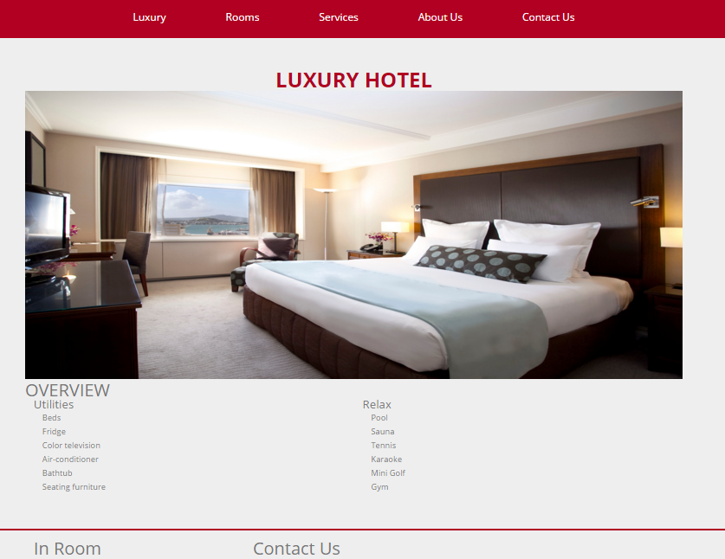
interface expected

Slide 15
UI-Router
angular-ui-router.min.js

Slide 16
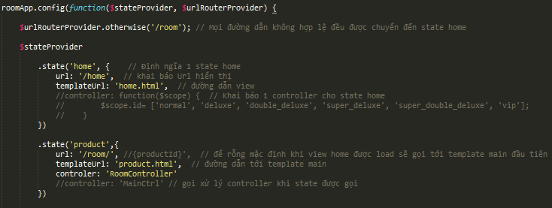
UI-Router
Utilities

Slide 17

UI-Router
Utilities

Slide 18
UI-Router
Risk
js files customs corrupted - not fixed yet
Improve
Room detail
Fix js files when use UI-Router

Slide 19
Demo
Host without UI-Router
hookusai.github.io
Host with UI-Router
luxuryrisk.github.io

Slide 20
End
Thanks For Watch
Special Thanks
Mr. Quý (mentor)
Ms. Trinh

